Slide 1
Blockchain-Based Decentralized Voting System
Rahul Dudani D17C - 18

Slide 2
Problem Statement
Traditional voting systems rely on centralized databases, which create single points of failure.
Data tampering and unauthorized access can compromise election integrity.
Lack of transparency reduces public trust in electoral outcomes.
Manual verification and dependency on intermediaries slow down the process.
Ensuring both voter anonymity and data security is challenging in existing systems.

Slide 3
Significance of Blockchain in the Voting Domain
Blockchain technology revolutionizes the voting process by introducing transparency, decentralization, and immutability.
Each vote is treated as a transaction, validated through consensus, and permanently recorded in the blockchain ledger.
Key Advantages:
Transparency: Every vote is publicly verifiable on the blockchain.
Security: Cryptographic mechanisms prevent tampering and duplication.
Immutability: Once recorded, votes cannot be altered or deleted.
Decentralization: Removes single points of failure and centralized control.
Auditability: Enables real-time monitoring and verifiable election results

Slide 4

Stakeholders and Their Roles
Stakeholder Election Commission
Role / Responsibility
Deploys the smart contract and initializes the voting period.
Authenticate using MetaMask and cast votes securely on the blockchain.
Participate in the election; their vote counts are updated via smart contract logic.
Verify transactions on the blockchain and validate election results.
Voters
Candidates
Auditors / Observers

Slide 5
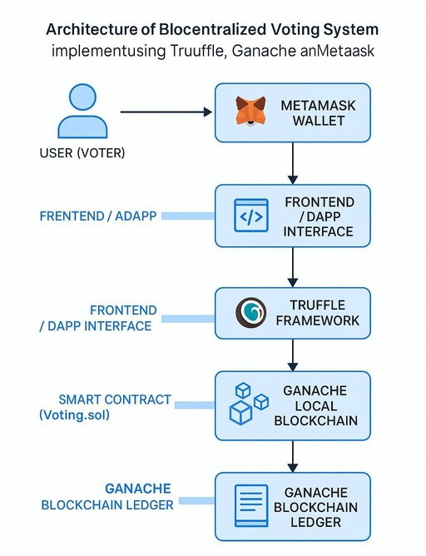
Architecture Diagram:

Slide 6
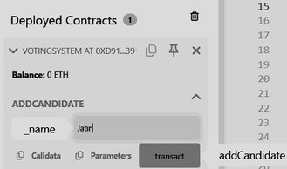
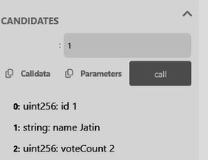
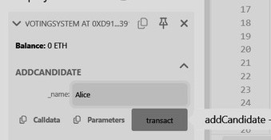
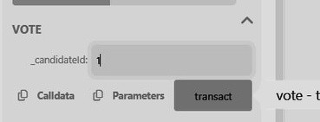
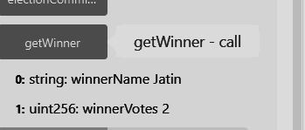
Experiment 6
Adding Candidate
Adding Candidate
Cast Vote
Check Votes using candidates(id) function
Declare Winner using getWinner()

Slide 7
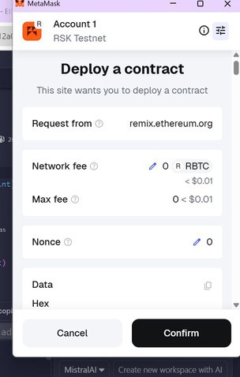
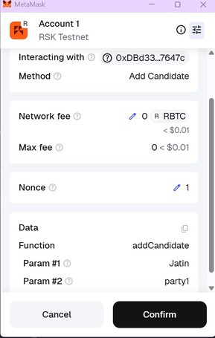
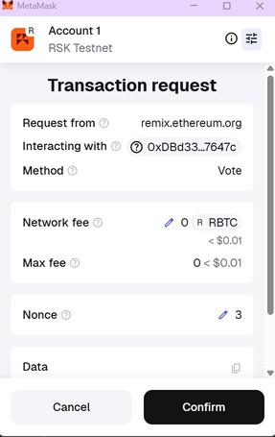
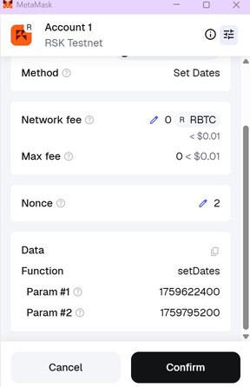
Experiment 7
Deploying the contract with metamask
Adding a candidate
Set voting dates
Vote

Slide 8
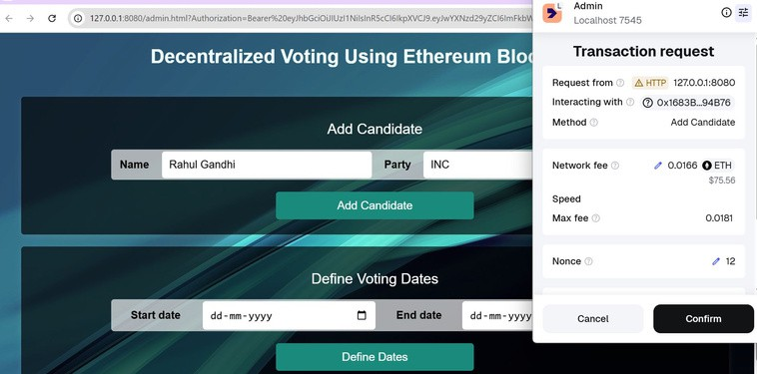
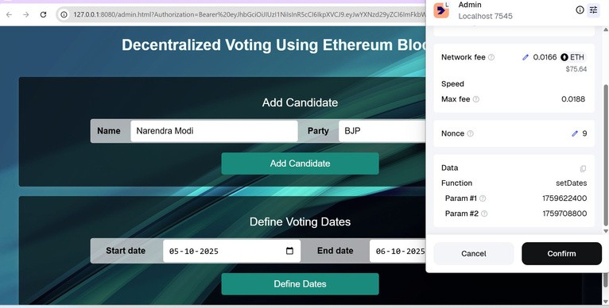
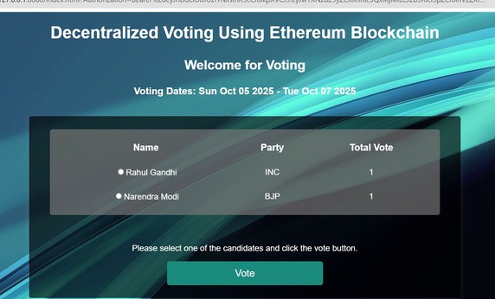
Experiment 8

Slide 9
Conclusion
Successfullyimplemented a Decentralized Voting System using Truffle, Ganache, and MetaMask.
Ensured security, transparency, and immutability of votes through blockchain technology.
Demonstrated wallet-based authentication and smart contract automation for vote recording.
Eliminated the need for intermediaries, ensuring a trustless and tamper-proof process.
Showcased how local blockchain networks can simulate real-world decentralized systems.
Proved the potential of blockchain for future large-scale e-governance and secure digital elections.

